Slide 1
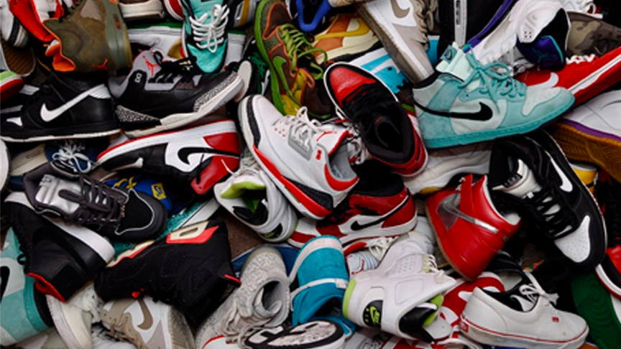
“#MUST COP” SNEAKERS
Matthew Tom
January 26,2019

Slide 2
Introduction
Secondary Sneaker Resell Market
Decisions on “flipping” sneakers

Slide 3
Problem Statement
To predict the percent return of sneakers in the sneaker resell market

Slide 4
Methodology
Scrapped 3000 pairs of Nike, Jordan and Adidas Shoes
StockX.com

Slide 5

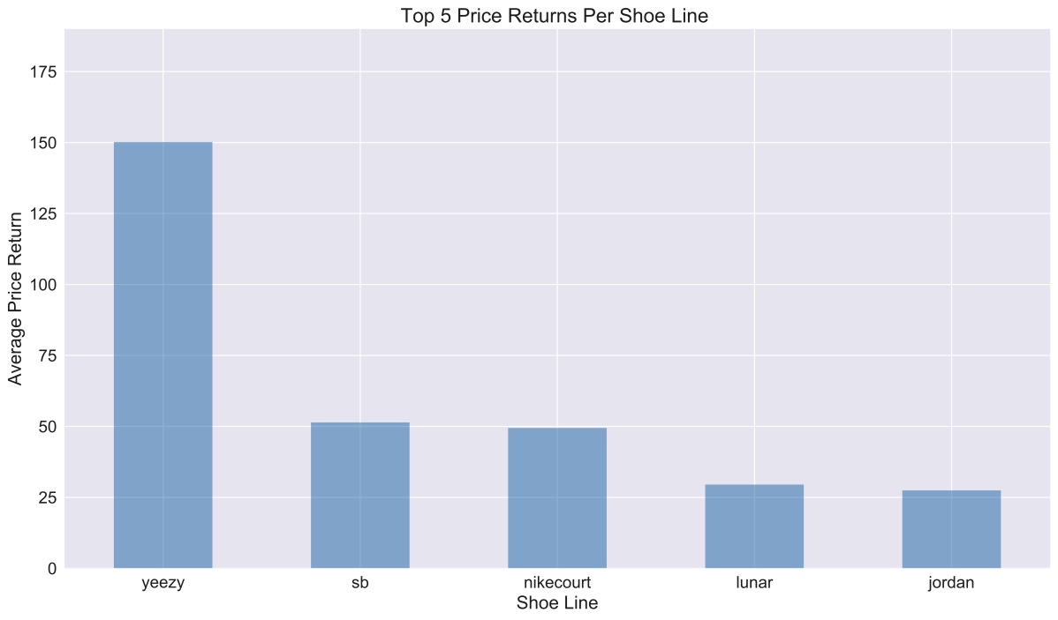
Exploratory Data Analysis

Slide 6
Results
Model | Root Mean Squared Error [%]
Linear Regression (Baseline) | 27.74
Linear Regression with Ridge (alpha = 2) | 20.83
Linear Regression with Lasso (alpha = 0.2) | 20.90
Linear Regression with Elastic Net (alpha = 0.01 L1_ratio= 0.9) | 21.48
XG Boost Regression | 11.09

Slide 7
Conclusion
Key Takeaways
1) Last Sell Price
2) Annual High / Annual Low
3) Yearly Shoes Sold
4) BUY ANY SHOE WITH THE ‘YEEZY LINE’

Slide 8
Future Work
Individual Sales History of Each Shoe
Cross-reference Instagram or Twitter hashtag counts of each shoe line

Slide 9
Thank You !!!!

Slide 10
Appendix

Slide 11
XGBOOST :
{'colsample_bytree': 0.8, 'gamma': 0, 'learning_rate': 0.07, 'max_depth': 3, 'min_child_weight': 1.5, 'n_estimators': 10000, 'reg_alpha': 0.01, 'reg_lambda': 0.01, 'subsample': 0.6}

